Slide 1

ML BASED PROCESSED FOOD CLASSIFICATION
31136 - SUSHIL KARPE
31141 – LAUKIKA KULKARNI
Sit Dolor Amet

Slide 2
Index:
Problem statement
Objective and Outcome
Data Collection
Metrics Used
Methodology
Results
Conclusions
References

Slide 3

Problem Statement :
Using Ml based approach we can easily categorize these processed foods and can know if the food product is fit consume or not.
The Ml based approach should cover large scale and types of processed foods. It must implement classification models that should be able to classify the products based on their nutritional content(food nutrient label).

Slide 4
Outcome
Objective:
To implement suitable ML algorithm and models to categorize the processed food items such that we will know if they suitable for our health or not
By this implementation we will get to know that if the food is fit to consume or not and also the categorization extent of the processed food items

Slide 5
Data Collection
WE HAD TO COLLECT DATA FROM VARIOUS AGE GROUPS REGARDING THEIR PREFERENCES FOR PROCESSED FOOD ITEMS AND THE CHOICE OR EXTENT OF CONSUMPTION
WE ALSO DIVIDE THEM ACCORDING TO THEIR AGE GROUP AND GENDER

Slide 6
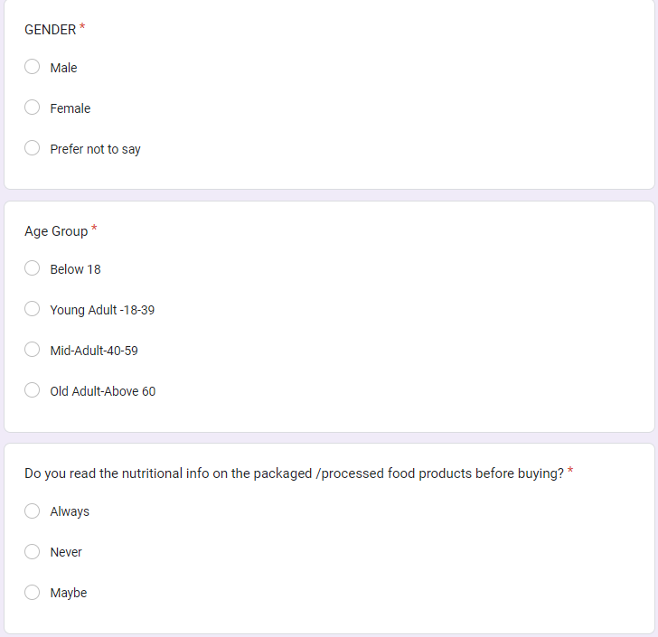
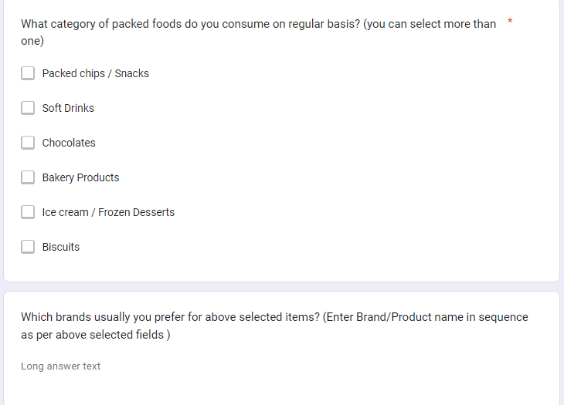

Slide 7
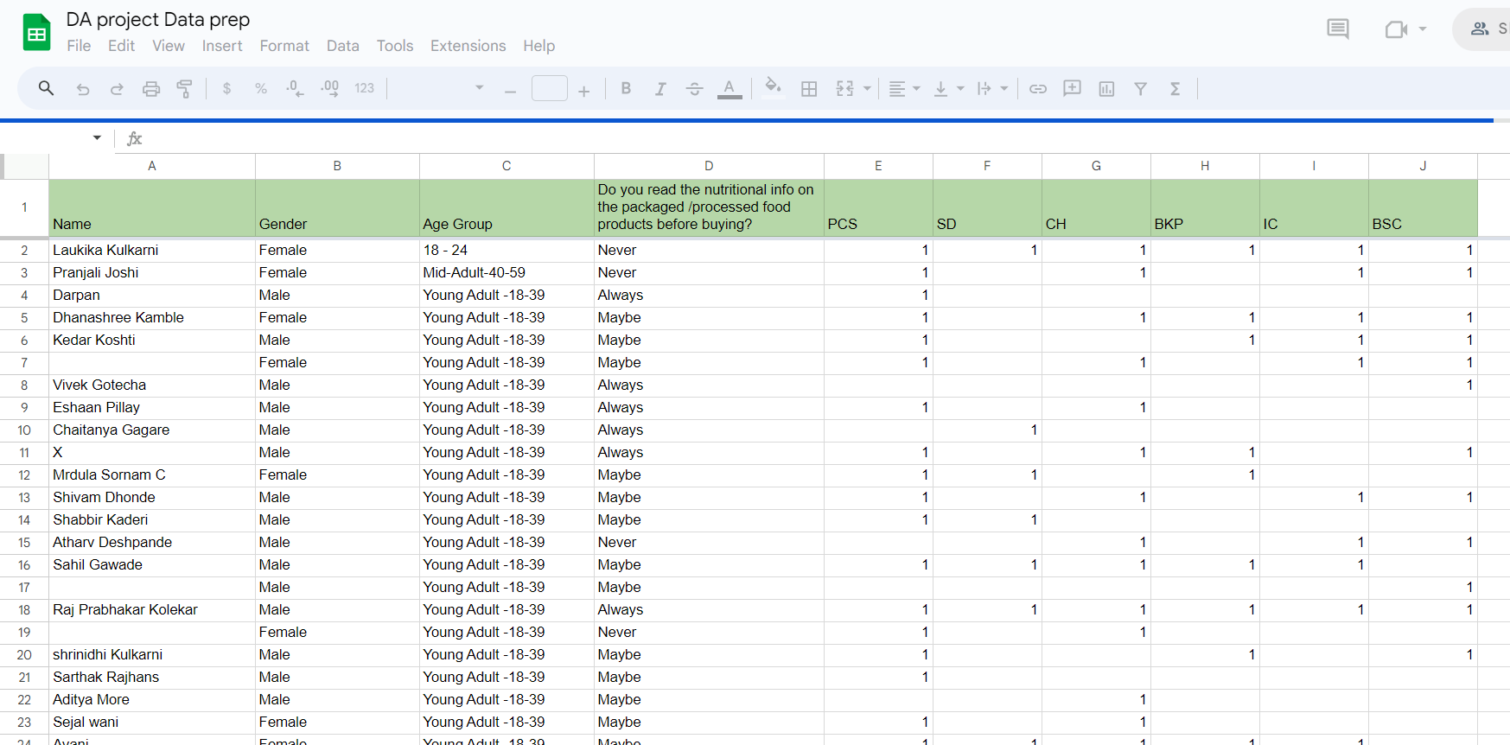

Slide 8
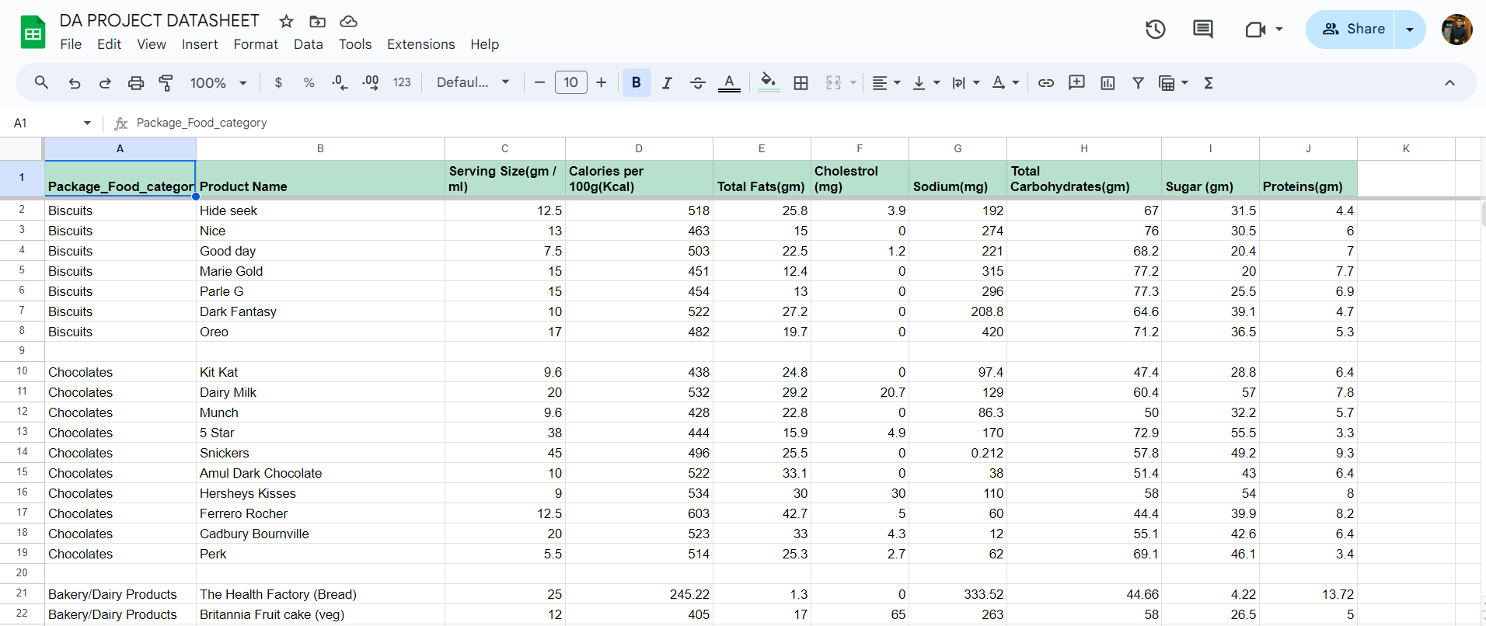

Slide 9

METRIC USED:
The METRIC which we have used has been sourced from the Food Safety and Standards Authority of India (FSSAI) website.
They serve as predefined criteria for the classification of food products based on their nutritional attributes.

Slide 10

METHODOLOGY:
We first compare the threshold values given by FSSAI with the threshold values of the products from datasheet according to their serving size
This gives us the metric that the food product is ‘fit to consume’, ‘moderately healthy’ or ‘not healthy’
But running this function every time for each and every product depending on their nutrient content on food labels in real life will take more computation power.
So we develop a ML based predictive model to train on already obtained actual categorization using above approach and achieving optimal accuracy and precision.
This model then can be used to categorize based on the nutrient content (food nutrients label) the product and still using less computational power

Slide 11
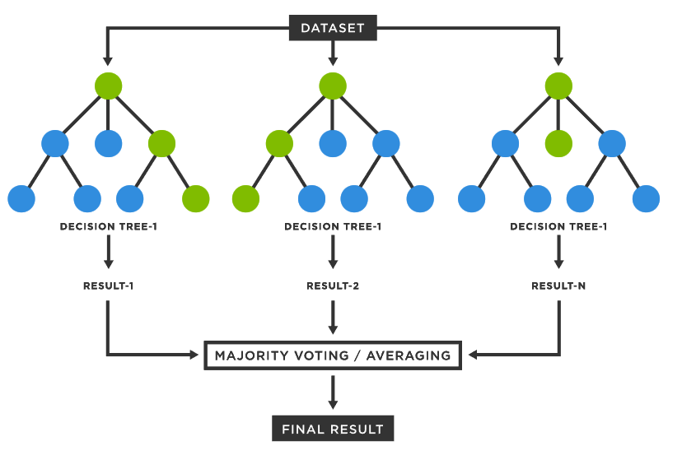
ML Algorithms Used :
1. Random Forest Classifier :
Step 1: Select random samples from a given data or training set.
Step 2: This algorithm will construct a decision tree for every training data.
Step 3: Voting will take place by averaging the decision tree.
Step 4: Finally, select the most voted prediction result as the final prediction result.

Slide 12
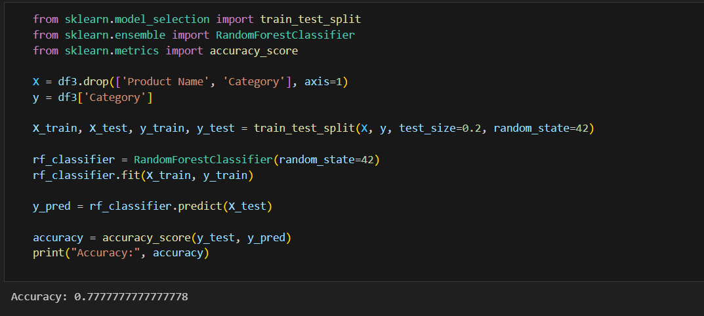
Random Forest Pseudocode:

Slide 13
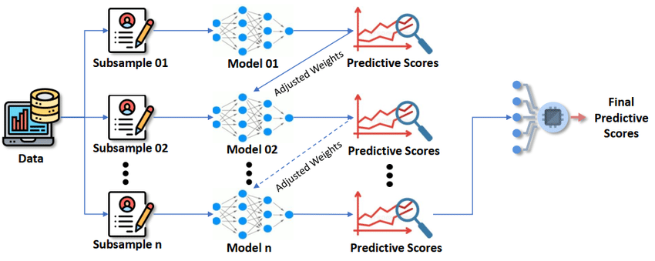
2. XGBoost Algorithms:
Initialization: XGBoost starts by initializing the model with default parameters or user-defined settings.
Construction of trees: It builds an initial decision tree using a greedy algorithm, where nodes are split to minimize a loss function.
Gradient computation: The algorithm computes the gradient of the loss function for each instance in the dataset.
Approximate tree learning: XGBoost uses gradient boosting to optimize subsequent trees, where each tree is trained to correct the errors of the previous trees.
Regularization: Regularization techniques such as pruning and column subsampling are applied to prevent overfitting and improve generalization.
Prediction: The final model predicts the output by aggregating the predictions of all individual trees, typically using a weighted sum.

Slide 14
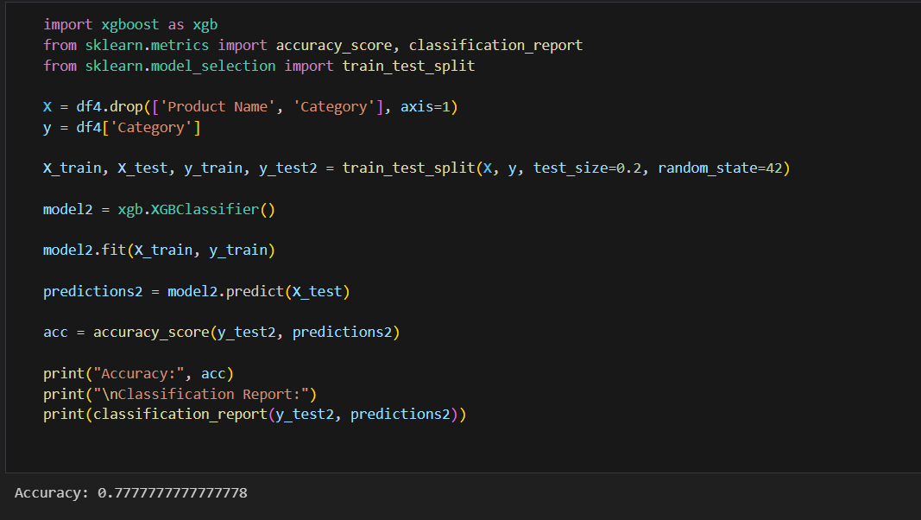
XGBoost Algorithm pseudocode:

Slide 15
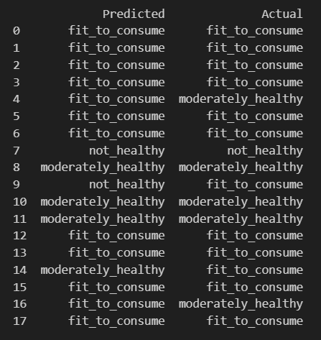
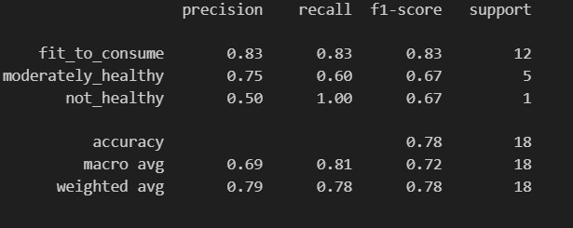
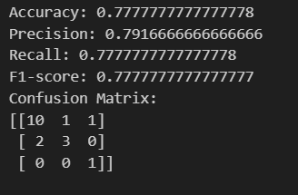
RESULT:
1. Random Forest Classifier:

Slide 16
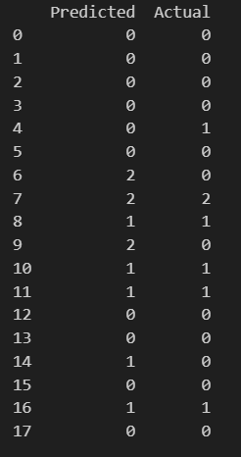
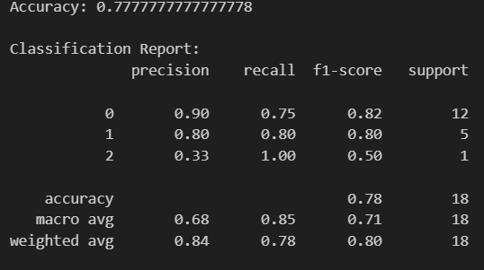
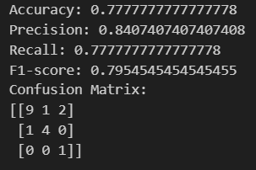
2. XGBoost Algorithm:

Slide 17
Comparisons of Model
Accuracy: Both classifiers achieve the same overall accuracy of 0.78.
Precision: Random Forest generally has higher precision for all categories compared to XGBoost, except for "not_healthy" where it's lower. XGBoost achieves the highest precision for "fit_to_consume" but the lowest for "not_healthy".
Recall: Random Forest has higher recall for "fit_to_consume" while XGBoost performs better for "moderately_healthy". Both classifiers have perfect recall for "not_healthy".
F1-score: XGBoost generally outperforms Random Forest in terms of F1-score, especially for "fit_to_consume" and "moderately_healthy" categories.

Slide 18

Conclusion
Both Random Forest and XGBoost classifiers demonstrated categorizing processed foods based on their health attributes.
Random Forest exhibits higher precision, particularly in categorizing foods as "fit_to_consume" and "not_healthy," while XGBoost achieves better overall performance metrics.
Challenges exist in accurately identifying moderately healthy foods, as indicated by lower precision and recall scores for this category in both models.
Future implementations could explore a hybrid approach combining the strengths of Random Forest and XGBoost, alongside further feature engineering and model optimization techniques.
Integrating real-time data streams and user feedback could enhance system adaptability and relevance, facilitating informed dietary choices and promoting healthier eating habits among consumers.

Slide 19
References:
LM Aiello, R Schifanella, D Quercia, L Del Prete; EPJ Data Science, 2019. Large-scale and high-resolution analysis of food purchases and health outcomes
Gitanjali M. Singh , Renata Micha , Shahab Khatibzadeh, Peilin Shi, Stephen Lim, Kathryn G. Andrews, Rebecca E. Engell, Majid Ezzati, Dariush Mozaffarian , Global Burden of Diseases Nutrition and Chronic Diseases Expert Group (NutriCoDE); Global, Regional, and National Consumption of Sugar-Sweetened Beverages, Fruit Juices, and Milk: A Systematic Assessment of Beverage Intake in 187 Countries; Published: August 5, 2015
Susan E McCann1, James R Marshall, John R Brasure, Saxon Graham and Jo L Freudenheim1; Analysis of patterns of food intake in nutritional epidemiology: food classification in principal components analysis and the subsequent impact on estimates for endometrial cancer; Submitted 4 January 2001: Accepted 6 March 2001
Analyzing the Nutritional Content of Packed Foods using Smart phone Camera/Computer vision and Machine Learning - A Comprehensive review; Ms E Anitha, Dr. A Bazila Banu;
Procedures for Estimating Nutrient Values for Food Composition Databases Sally F. Schakel, I. Marilyn Buzzard, and Susan E. Gebhardt ; Received July 10, 1996

Slide 20

THANK YOU!!

